Slide 1
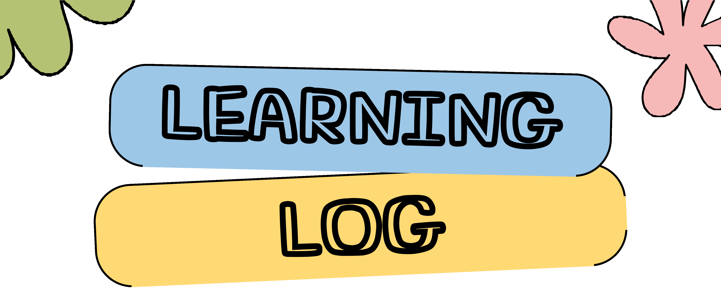
LEARNING
LOG
Production House| Semester 6 - Extended Reality
By Diandzhela Mateeva 214008

Slide 2
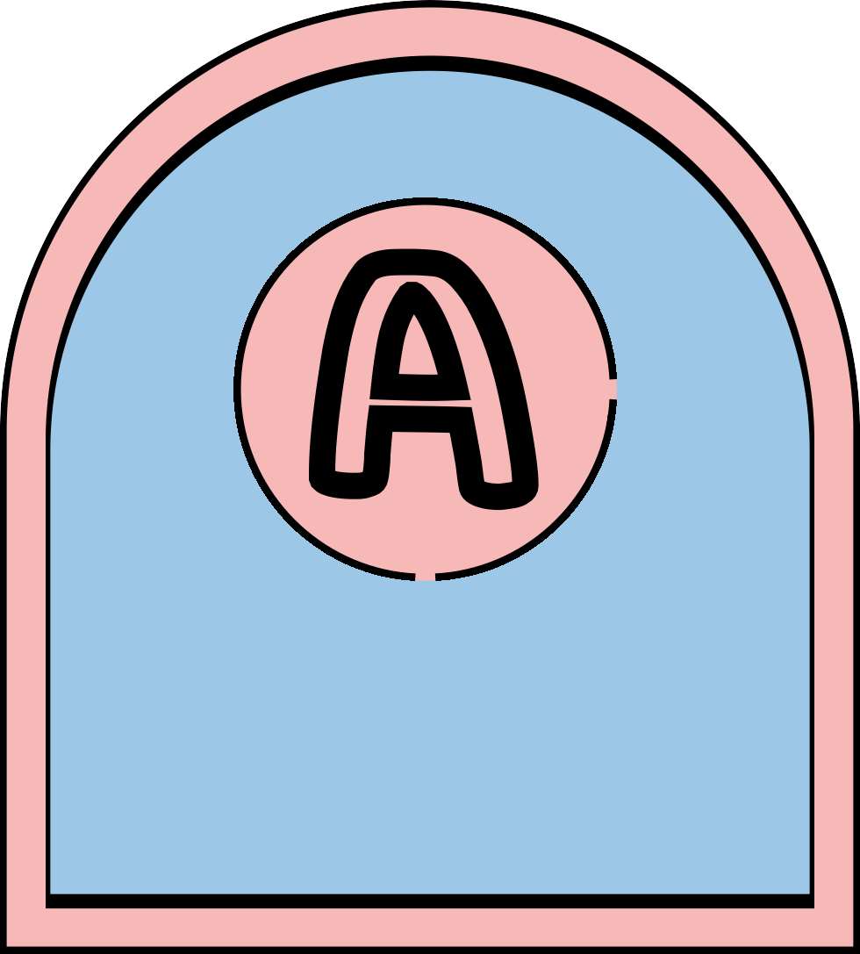
A
START OF THE COURCE
This is a brief outline of where you are, what you would like to learn and what you want out of these
Section
next 15 weeks.

Slide 3
WHERE AM I
STARTING?
During the first week of production house, our lecturers introduced the whole course to us and what we need to do for the next 15 weeks. We played a game to get to know each other, which was a great way to brak the ice for the whole team.
Key takeaways:
For this course it is very important to understand how the whole system works.
Action point: One thing that I would like to learn is how to set up the motion tracking system.
As a set designer, I typically have free creative freedom to create a set from scratch (including the environment's mood and the set's look), but after I started the course, I learned that this would not be the case because the set had already been selected. My primary responsibility was to figure out how to integrate physical props into the selected set so that it all seemed to be in a real location.

Slide 4
MY GOALS
Goal 1
Learn how to create sets for virtual production
Specific: Learn how to blend the physical set with the virtual one
Measurable: Make al least one cohesive virtual shot using props
Attainable: This goal is challenging because of the lack of online learning materials, but it is still attainable as I have a close communication with the virtual designer person (Maksim) and we will work together during the course.
Relevant: This goal is relevant as it will be my main task durong this course Time-Bound: This goal needs to be achieved before the first shooting day
Goal 2
Expand my costume library/market
Specific: Discover new potential places that I can rent out good costumes or buy costume pieces of quality. Measurable: Explore at least 2 new costume markets/library
Attainable: This goal is challenging because we live in a small city with finite number of stores, but also as we are still students, we don’t know where to find quality costume pieces. So far I’ve only made use of the finite local stores but however I think this goal is achievable by branching out to different locations or online stores.
Relevant: This goal is relevant as it is part of my task for this project. In addition this will help me for my professional skills after I graduate.
Time-Bound: This goal needs to be achieved by the end of week 5

Slide 5
B
LEARNING LOG
Intended learning outcomes
Section

Slide 6
ILO 2.1
Be able to illustrate how this technology is changing the media industry especially in the field of virtual production with green
screen.
This technology
is relatively new and allows media professionals to work more
efficiently. While using the traditional green screen technology, industry people experience some challenges:
since the set is virtual and added in post, the actors need to imagine the set while filming, which can be difficult
extensive post-production time and effort is required.
When using virtual production, the background is visible on the LED screens and it is rendering in real-time while using a game software like Unreal engine to project a high quality background and effects. This technology is efficient for post-production process as it saves the step of replacing the green screen with environmental effects due to the real-time rendering. Moreover, VP can be flexible as environments can be changed quickly without the need for physical set adjustments.

Slide 7
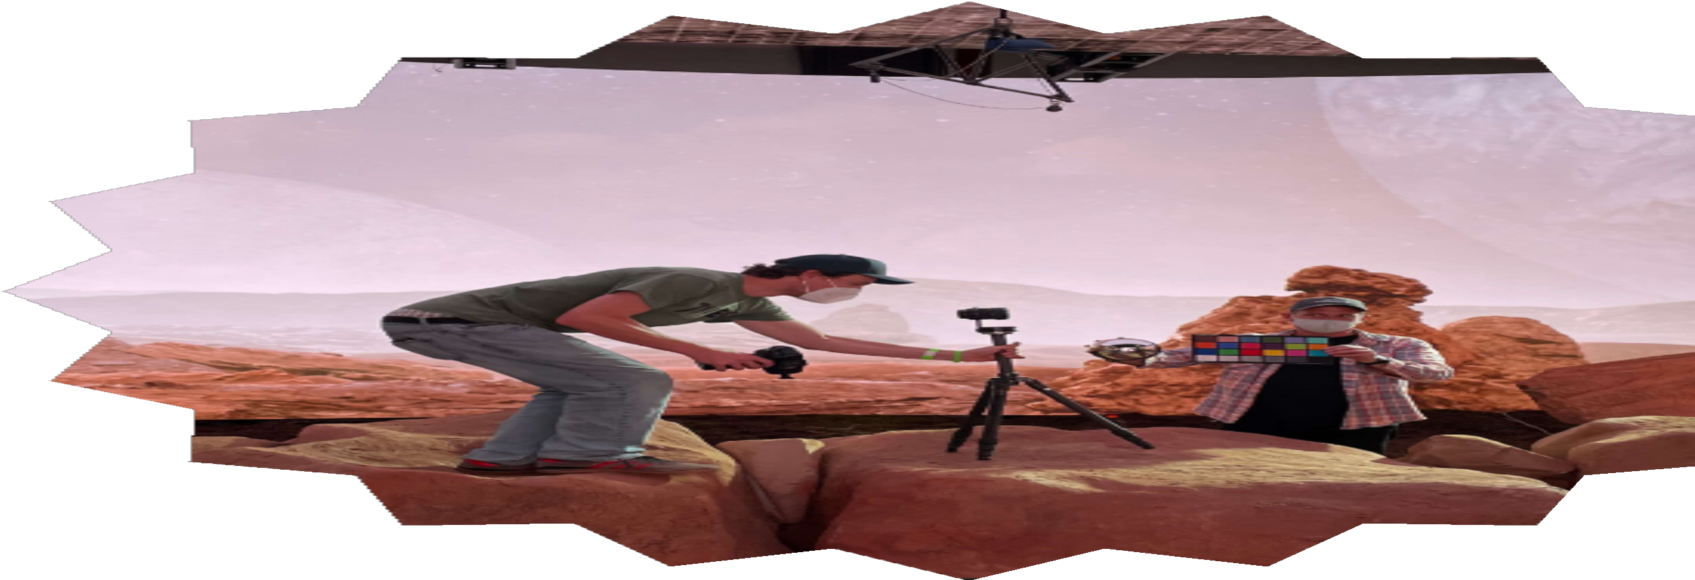
ILO 2.2
Conclude how approaches to technical positions such as sound, set design and cinematography etc. differ within a virtual production context.
As I was part of the production designers for this project I can conclude on how set design within VP differs from the traditional filmmaking.
When creating a traditional set for a movie, we need a physical construction of the set. This can be time-consuming and requires a lot of intensive labor work. In addition, it requires a lot of resources, such as big studio spaces or on- location sets as well as supplies which can add a good amount of costs for the production.
When it comes to virtual production set design is first executed using digital tools, such as software engine like Unreal Engine or Maya. By using this technology, the production design is done more efficiently, while reducing time and resources needed for the construction. Unlimited possibilities for creativity are available with virtual set design. Regardless of whether an environment is capable of being created, designers can develop it and then constantly modify it in real time to fit the director's vision or change course as the plot demands. This production also costs less as set designers use less physical props than usual, as they are only needed to blend the background with the foreground and also when actors are interacting with the props.
I order to create a good physical XR set which blends perfect with the virtual one, you need to work side to side with the VA. Here are some specific tasks a set designer can perform to help the VA department:
Use a scanning software provided by technical department to create blockout models of each real prop.
Take detailed measurements of each prop and the distance of each important element to the screen. All of these measurements are crucial for keeping track of scale,
Providing the VA department with detailed pictures of cloth, or any important materials. This will help them a ton with creating realistic materials that match the real world.
The scale of our project is very small and it took me a
while to figure out these workflows. I learned about them by consistantly checking in with our VA.

Slide 8
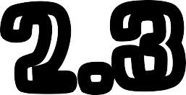
ILO 2.3
Understand terms and their relevance in VP such as camera tracking, multi- user and moire.
There are a lot of terms related to virtual production and I didn't not have enough time to learn them all but still managed to understand and remember the most important ones:
Camera tracking is the process of multiple Vicon cameras constantly detecting and updating the position of an object on the set. In order for that to happen, the object needs to have a specific configuration of tracking dots. These dots are placed randomly at first and the Vicon cameras are configured to track and recognize this random configuration as a specific object.
Multi-user is a the plugin that we use to enable real-time rendering on the LED screen.
Shogun is the software that we use to calibrate all the camera tracing.
LED Volume is a combination of small led panel which created the big screen that we use for our XR production.

Slide 9
ILO 3.1
Reports on learning progress and updates plans in a well-written, concise format with appropriate visual communication, guided
by active engagement with feedback and outlines learning goals.
In my weekly log, I reported on what I have learned each week. There were weeks that consisted of mainly hands on tasks, during which I didn’t learn anything new. Here are a few example slides in which I stick to a learning breakdown and action points format:
Week 3 - This week was part of the pre-production and my time was moslty spend doing research. In the slide I talk about my findings and things I’ve learned.
Week 4 - In the beginning of the project I was curious how does the camera tracking work and during this week I got the opportunity to get a hands on experience on how to calibrate it.
Week 5 - Heading towards the end of pre-production, this week was filled with expanding my library of prop and costume warehouses.
These are only a few examples and as you can see most of my learnings were evidenced during the first stages of the project. However this seems only logical to me since its a completely new type of producion and I had to familiarize myself with all the necessery workflows and pipelines. During the later stages of the project I still kept learning new things however they were mainly due to trial and error.
When it comes to planning there were a few drawbacks, but they were mainly team related. My personal work went smoothly overall and I didn’t have to adjust too much.

Slide 10
ILO 3.2
Reflects on team and individual choices made in regards to their role and when constructing a virtual production shoot.
During the XR shooting days, the whole team was in general a bit stressed and time pressured. Everyone did a good job performing their roles as well as they could. As a team, we succeeded in making the actors feel more relaxed which helped understand better the new surrounding and technology that we were using for this production and resulted in better performance from their side.
However there were some small issued that we faced:
During the first two shooting days, we faced some issues with noice pollution caused by events in the Sports bar, which resulted in a lot of frustrations, distractions, time waste and audio complications. We learned from our mistake and made sure to reserve the Sports bar and have a good and structured schedule without any interruptions.
One another thing that we could have done differently is to record the distorted audio separately in the audio booths and focus more on visual and the performance on set.
Looking at my individual choices that I made during the shooting days, I can say that I could have done some things differently. In general< I think I did a good job with my role on shootin days which was a hair and make-up artist and PA. I achieved the looks of both actors and assisted the crew and actors during the filming process. During the last day I wasn’t that involved in the project as much as I wished to. The reason for my distraction was the time pressure with my other projects. As a professional individual such attitude is not acceptable and I will try to not repeat this attitude again.

Slide 11
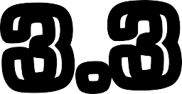
ILO 3.3
Evaluates individual development and shows improvement and reflection based on these feedback moments.
During this course was filled with great opportunities to learn something new. I was glad to be part of this project and to learn tons of information about a this new technology. I entered this course with only knowledge on traditional set design, but had the opportunity to expands my skills and learn a valuable knowledge on how to blend the virtual world with the physical objects. At the beginning of the course, I felt worried that I would not succeed with my tasks and the work that I do will ruin the film that we needed to deliver at the end of the semester. In order to perform better, I started to research techniques that will help me create a good looking set that will blend with the virtual background. While gathering the props and furniture, I received feedback from some peers on how the set is turning out and if I had to change some of the configuration of the set or replace some of the objects.
Towards of the end of the course, I receive a structured feedback from 3 of the people I worked with during the XR project. Overall, from the feedback that was given to me I understood that I achieved to be a professional and maintain a high quality of work. During my previous years of university, I frequently was told that I need to develop my communication skills as I was lacking a lot in this aspect. During this year, I am happy to see that I achieved to develop this skill. Some points of improvement that I noted from my peers was to let people know when I have to leave early, so we wrap together as a team. Moreover, try to be more on time.

Slide 12
C
REFLECTION
Section

Slide 13
WHAT DID I ACHIEVE THIS COURSE?
The most significant achievements this course
My most difficult challenges in this course
The most important lessons I learned
Managed to provide costumes that are appropriate. for the specific time period Managed to connect and establish regular and successful communication with my teammates.
Managed to complete my SMART goal and increase ny pool of prop and costume warehouses both onsite and online
Learned what it takes to be a set designer for Virtual Production. What are the main workflows and how I can improve my current skillset
It was challenging to understand how the whole XR system works
I was also challenged to find online learning materials related to set design within virtual production
I am used to setting specific moods and implying different feelings by using creative set design. was previously able to make last minute decisions or regularly adjust the set to match my creative vision. However working on a set for an XR production prevents me from doing that. Mainly because each small adjustment influences the blend between the real world and the 3d one.
Matching the virtual background of the ballroom with the physical furniture and props was challenging, requiring meticulous attention to detail and coordination. Working on an XR production as a set designer is much different than the normal setting.
There are a lot more limitations due to the technical aspec of creating a seamless blend. Each creative decision also needs to be backed up by a technical aspect.
Understanding how the entire system works within XR was initially daunting, but persistence paid off

Slide 14
WHAT NEEDS TO BE IMPROVED IN THIS COURSE?
What I liked about this course
What needs improvememt in this course
What did you wish you had learnt more of
The ability to have a hand-on experience
More structured teaching materials
I don’t have much experience with this specific grading system and some of the ILO’s felt a bit unclear. Maybe a more detailed rubric could be helpful.
More teaching department Possibly adding
materials for
some tutorials or
with the newest technology in the film industry
The course didn’t really feel like an academic course but more like a fun tutorials which pushed me to be more involved and actually learn the more technical parts of the course
each
workshops to the teaching course

